Slide 1
6. Optimization Linear programming
Laura Hervert Escobar

Slide 2
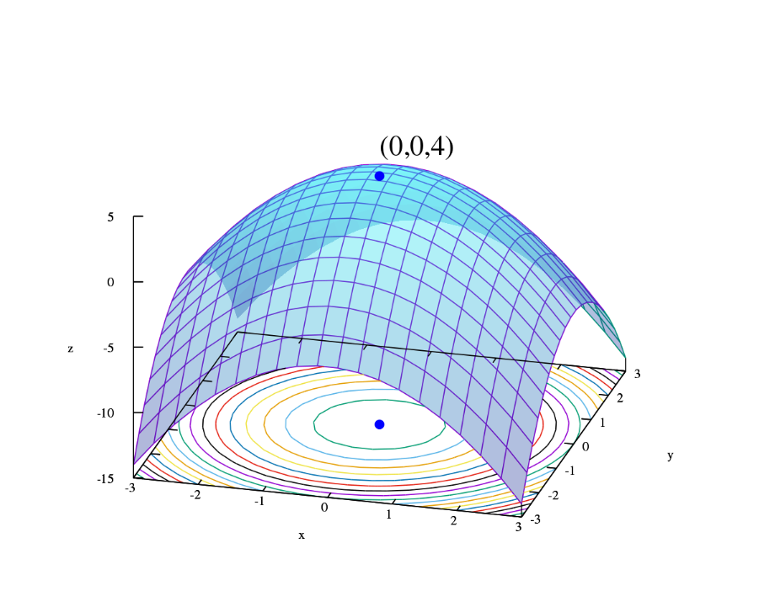
Optimization
Optimization is the act of achieving the best possible result under given circumstances.
In design, construction, maintenance, ..., engineers have to take decisions. The goal of all such decisions is either to minimize effort or to maximize benefit.
The effort or the benefit can be usually expressed as a function of certain design variables.
Hence, optimization is the process of finding the conditions that give the maximum or the minimum value of a function

Slide 3
Linear programming
It is an optimization method applicable for the solution of optimization problem where objective function and the constraints are linear
It was first applied in 1930 by economist, mainly in solving resource allocation problem.
During World War II, the US Air force sought more effective procedure for allocation of resources.
George B. Dantzig, a member of the US Air Force formulate general linear problem for solving the resources allocation problem.
The devised method is known as Simplex method.

Slide 4
Standard form of a Linear Problem (LP)
Minimize
Subject to.

Slide 5
Standard form of a Linear Problem (LP)
Minimize
Subject to.

Slide 6
Characteristics of Linear Problem (LP)
The objective function is minimization type.
For maximization problem.
Equivalent to.
All constraints are equality type
All the decision variables are non-negative

Slide 7
Characteristics of Linear Problem (LP)
All constraints are equality type.
If it is less than type.
It can be converted to.
If it is greater than type.
It can be converted to.
SLACK VARIABLE
SURPLUS VARIABLE

Slide 8
Characteristics of Linear Problem (LP)
All the decision variables are non-negative
Is any variable x_{j} is unrestricted in sign, it can be expressed as
Where.

Slide 9
Conditions of Linear programming
There are m equations and n decision variables.
If m > n, there will be m-n redundant equations which can be eliminated
If m = n, there will be an unique solution or there may not be any solution
If m < n, a case of undetermined set of linear equations, if they have any solution, there may be innumerable solutions.
The problem of linear programming is to find out the best solution that satisfy all the constraints

Slide 10
Algebraic modelling language
Generally speaking, we follow a four-step process in modeling.
Develop an abstract model.
Populate the model with data.
Solve the model.
Analyze the results.
These four steps generally involve different pieces of software working in concert.
For mathematical programs, the modeling is often done with an algebraic modeling system.
Data can be obtained from a wide range of sources, including spreadsheets.
Solution of the model is usually relegated to specialized software, depending on the type of model.

Slide 11
Open Source Solvers. COIN-OR
COIN-OR FOUNDATION
A non-profit foundation promoting the development and use of interoperable, open-source software for operations research.
A consortium of researchers in both industry and academia dedicated to improving the state of computational research in OR.
A venue for developing and maintaining standards.
A forum for discussion and interaction between practitioners and researchers.
COIN-OR FOUNDATION
A collection of interoperable software tools for building optimization codes, as well as a few stand alone packages.
A venue for peer review of OR software tools.
A development platform for open source projects, including a wide range of project management tools

Slide 12
PuLP. Algebraic Modeling in Python
PuLP is a modeling language in COIN-OR that provides data types for Python that support algebraic modeling.
PuLP only supports development of linear models.
Main classes Lp Problem Lp Variable
Variables can be declared individually or as “dictionaries” (variables indexed on another set).
We do not need an explicit notion of a parameter or set here because Python provides data structures we can use.
In PuLP, models are technically “concrete,” since the model is always created with knowledge of the data. However, it is still possible to maintain a separation between model and data.

Slide 13
Notes about the model
We can use Python’s native import mechanism to get the data.
Note, however, that the data is read and stored before the model.
This means that we don’t need to declare sets and parameters.
Constraints.
Naming of constraints is optional and only necessary for certain kinds of post-solution analysis.
Constraints are added to the model using an intuitive syntax.
Objectives are nothing more than expressions without a right hand side.
Indexing.
Indexing in Python is done using the native dictionary data structure.
Note the extensive use of comprehensions, which have a syntax very similar to quantifiers in a mathematical model.

Slide 14
Note about the data
We are storing the data about the bonds in a “dictionary of dictionaries.”
With this data structure, we don’t need to separately construct the list of bonds.
We can access the list of bonds as bonds.keys().
Note, however, that we still end up hard-coding the list of features and we must repeat this list of features for every bond.
We can avoid this using some advanced Python programming techniques.

Slide 15
Pulp
Initializing model – LpProblem()
LpPROBLEM(name=“NoName”, sense=LpMinimize)
Define decisión variables – LpVariable()
LpVariable(name, lowBound=None, upBound=None, cat=‘Continuos’, e=None)
name. Name of the Variable
lowBound . Lower Bound
upBound . Upper Bound
Cat. The type of variable this is
Continuos (default)
Integer
Binary
e=None

Slide 16
Pulp
Define Objective Function
model += 20 * A + 40* B
Define constraints
model += 0.5 * A + 1 * B <= 30
model += 1 * A + 2.5 * B <= 60
model += 1* A + 2 * B <= 22
Solve the model
model.solve()

Slide 17
Example
RMC Laboratories is a small company that manufactures a variety of chemical-based products. In a particular production process, three raw materials are used to produce two products. a fuel additive and a solvent base. The fuel additive is sold to oil companies and is used in the production of gasoline and related fuels. The solvent base is sold to a variety of chemical companies and is used in household and industrial cleaning products. The three raw materials are mixed to make the fuel additive and the solvent base as follows.
RMC production is restricted by limited availability of all three raw materials. For the current production period, RMC has available the quantities given in the table.
Due to waste and the nature of the production process, unused materials in a production run cannot be stored, are useless, and must be discarded. The accounting department analyzed the production figures, assigned all relevant costs, and arrived at prices that, for both products, will produce a contribution to profit of \$40 per ton of fuel additive and \$30 for each ton of solvent base produced. Determine the amount of fuel additive and the amount of solvent base to be produced in order to maximize the contribution to total profit
 | Fuel Aditive | Solvent base | Available (ton)
Material 1 | 0.4 | 0.5 | 20
Material 2 | 0 | 0.2 | 5
Material 3 | 0.6 | 0.3 | 21

Slide 18
Mathematical model
Objective function.
Maximize z = 40x + 30y
Subject to.
0.4x + 0.5y <= 20
0.2y <= 5
0.6x + 0.3y <= 21
x, y >= 0

Slide 19
Example
Consider the following ingredients for making sausages
We’ll make 2 types of sausage.
Economy (>40% Pork)
Premium (>60% Pork)
One sausage is 50 grams (0.05 kg)
According to government regulations, the most starch we can use in our sausages is 25%
We have a contract with a butcher, and have already purchased 23 kg pork, that must go in our sausages.
We have a demand for 350 economy sausages and 500 premium sausages.
We need to figure out how to most cost effectively blend our sausages.
INGREDIENTS | COST ($/KG) | AVAILABILITY (KG)
Pork | 4.32 | 30
Wheat | 2.46 | 20
Starch | 1.86 | 17

Slide 20
The formulation of the model is.
pp=Pork in the premium sausages (kg)
wp=Wheat in the premium sausages (kg)
sp=Starch in the premium sausages (kg)
VARIABLES
pe=Pork in the economy sausages (kg)
we=Wheat in the economy sausages (kg)
se=Starch in the economy sausages (kg)
Objective Function
Minimize Cost=4.32(pe+pp)+2.46(we+wp)+1.86(se+sp)
Subject to.
Demand
pe+we+se = 350×0.05
pp+wp+sp=500×0.05
Types
pe≥0.4(pe+we+se)
pp≥0.6(pp+wp+sp)
Goverment regulations
se≤0.25(pe+we+se)
sp≤0.25(pp+wp+sp)
Availability
pe+pp≤30
we+wp≤20
se+sp≤17
Inventory
pe+pp≥23

Slide 21
Example
A company needs to make provisions for the following cash flows over the coming five months. −150K,−100K, 200K,−200K, 300K.
The following options for obtaining/using funds are available
The company can borrow up to$100K at 1%interest per month,
The company can issue a 2-month zero-coupon bond yielding 2%interest over the two months,
Excess funds can be invested at 0.3%monthly interest.
How should the company finance these cash flows if no payment obligations are to remain at the end of the period?
All investments are risk-free, so there is no stochasticity.

Slide 22

Solution- Understanding
A company needs to make provisions for the following cash flows over the coming five months. −150K,−100K, 200K,−200K, 300K.
The following options for obtaining/using funds are available
The company can borrow up to$100K at 1%interest per month,
The company can issue a 2-month zero-coupon bond yielding 2%interest over the two months,
Excess funds can be invested at 0.3%monthly interest.

Slide 23
X2=$$ from credit line
Y2 = $$ from bonds
Z1*1.003
X3=$$ from credit line
Y3 = $$ from bonds
Z2*1.003
X4=$$ from credit line
Z3*1.003
Z4*1.003
X1=$$ from credit line
Y1 = $$ from bonds
MONTH 1
150 K
MONTH 2
100 K
MONTH 3
-200 K
MONTH 4
200 K
MONTH 5
-300 K
Z1= extra$$ invested
Z2= extra$$ invested
X1*1.01
Z3= extra$$ invested
X2*1.01
Y1*1.02
Z4= extra$$ invested
X3*1.01
Y2*1.02
X4*1.01
Y3*1.02
V= $$ extra
Max f(x,y,z,v)=V
X1 + Y1- Z1 = 150
X2 + Y2 + 1.003Z1 - Z2 - 1.01X1 = 100
X3 + Y3 + 1.003Z2 - Z3 - 1.01X2 - 1.02Y1 = - 200
X4 + 1.003Z3 - Z4 - 1.01X3 - 1.02Y2 = 200
1.003Z4 - 1.01X4 - 1.02Y3 - V + = - 300
100 - Xi ≥ 0 (i = 1; . . . ; 4)
Xi ≥ 0 (i = 1, . . . , 4)
Yi ≥ 0 (i = 1, . . . , 3)
Zi ≥ 0 (i = 1, . . . , 4)
V ≥ 0

